Slide 1
IoT Based Vehicle Emission Monitoring System

Slide 2
Group Members:
Anuradha V. Patil. 15CMPN39
Abhishek C. Shinde. 15CMPN50
Suraj A. Unhale. 15CMPN55
Yogesh M. Mundra. 14CMPN39
Priyanka B. Gaikwad. 13CMPN11
Under Guidance of:-
Prof (Dr.) D.V. KODAVADE.

Slide 3
Introduction:
The Internet of Things(IoT) may be a new idea that has attached the attracted of both academic and industry. IoT is enforced as a network of interconnected object and communicates supported normal communication protocols.
In current scenario, one of the greatest problems that world is facing today is pollution, increasing every year and causing grave and also irreparable damage to the earth and air pollution is one of the serious environmental concerns of the urban asian cities including india.
So we design IoT based vehicle emission monitoring system to overcome these problem.

Slide 4
Literature Review:
Abinayaa Balasundaram, Aishwarya Udayakumar, Baladharshini Gopalan, Kavviya Bhaskaran, Barkathnisha Abdul Muthalip – “IoT Based Vehicle Emission Eonitoring System”, March 2017.
J.H. Visser, Member, IEEE, and R. E. Soltis, “Automotive Exhaust Gas Sensing System”

Slide 5
Problem Statement:
To develop IoT based module to detect the vehicle emission and monitor the emission .

Slide 6
Objectives:
It is observed from the analysis objective is to smart monitoring system is to be more innovative, user friendly and more efficient than any other system.
This smart monitoring system will detect and monitor the pollution in the environment.
It is helpful to minimize global warming.

Slide 7
Proposed Work:
The main source of the air pollution in cities is due to vehicles. The increase use of the vehicles in the cities results in vital increase in the emission load of various toxins into air.
Common gaseous pollution include carbon monoxide , hydrocarbons and other harmful gases produced by motor vehicle.
In order to minimize these issues, smart emission monitoring system has been used. In these system sensor such as co, hydrogen and gas sensors are connected to the input pins of Arduino and values are sensed.

Slide 8
If the sensed value goes beyond the threshold value which is set in the program then automatically message will sent to vehicle owner also emitted level will be monitored by National Environmental Agency by uploading data in web page and noise the buzzer for driver’s notice.

Slide 9
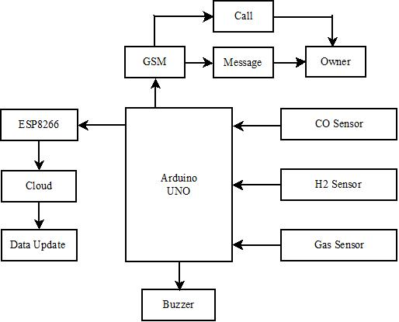
System Architecture:
Block Diagram:

Slide 10
Arduino:- It is microcontroller board based on the ATMega328(datasheet). It has 14 digital input/output pins, a USB connection, a power jack, RESET button.
Wi-Fi Module:- The ESP8266 Wi-Fi module is self contained with integrated TCP/IP protocol stack that can give any microcontroller access to your Wi-Fi network.
GSM Module:- GSM is mobile communication modem; it is stands for Global System for Mobile communication(GSM).

Slide 11
Hydrogen Sensor:- This is simple to use hydrogen gas sensor. They are used in gas leakage detecting equipment in home as well as industry application.
CO Sensor (Carbon Monoxide):-Tthey are used in gas detecting equipment for co in industry or vehicle.
Gas Sensor:- It is suitable for the detecting LPG,CH4,CO,alchohol,smoke and propane.

Slide 12
Methodology :
Module 1 :
In this systems the H2,CO,Gas sensors are connected to the Arduino and values sensed by sensors is the input to these Arduino.
Module 2 :
The values getting from sensors are compared with the threshold values which is set in the program and if the inputs values goes beyond the threshold value then buzzer gets alarmed.

Slide 13
Module 3 :
1. The message will send to the vehicle owner through GSM module also emitted level will be monitored .
2.The buzzer will alarm to inform vehicle driver.

Slide 14
Thank You!

